Slide 1
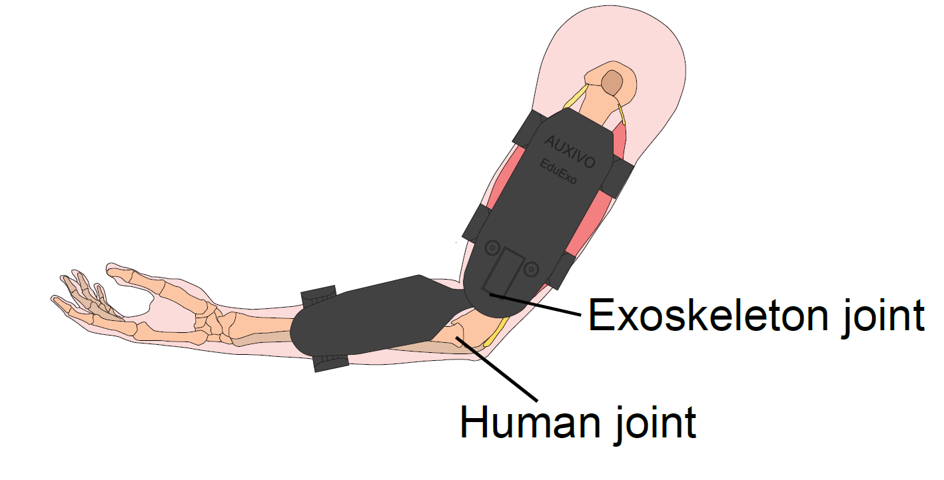
Introduction
This concept focuses on utilizing a specialized device for post-surgery rehabilitation of the elbow joint, which aims to facilitate the healing process and minimize re-injury risk.
Martina Adler, Sophia Pelligrini, Sandro Müller, Julia Jackermaier
EduExo2 Handbook

Slide 2
The concept for Post-Elbow Surgery Rehabilitation Device Martina Adler, Sophia Pelligrini, Sandro Müller, Julia Jackermaier

Slide 3
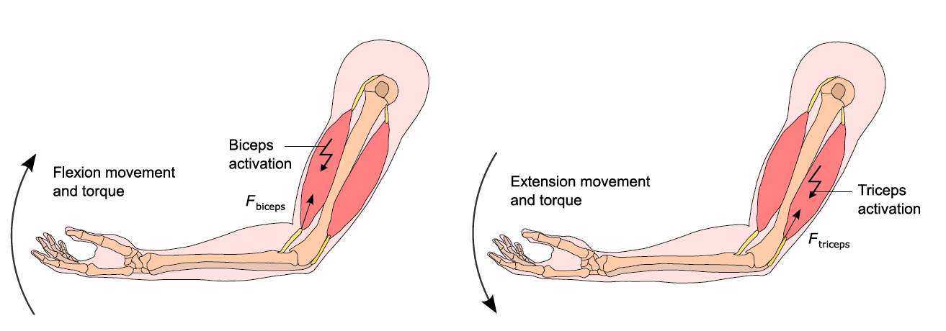
Initial Patient Situation & Rehabilitation Objective
The patient has undergone elbow joint surgery, necessitating a careful and controlled rehabilitation process
In the rehabilitation phase, the patient must restrict the degree of elbow flexion to allow sufficient time for proper healing
Martina Adler, Sophia Pelligrini, Sandro Müller, Julia Jackermaier
EduExo2 Handbook

Slide 4
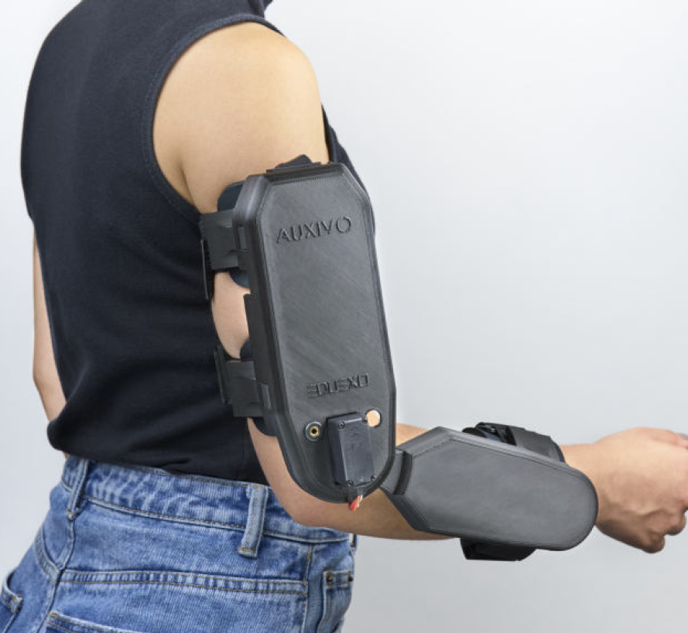
Our Innovative Approach
To achieve this objective effectively, we propose using a custom device to monitor and control the degree of elbow flexion
Our solution involves creating a Unity application where objects must be manipulated from one platform to another
Through this virtual interface, we can precisely regulate the elbow flexion angle, allowing patients to learn and maintain the appropriate range of motion
Martina Adler, Sophia Pelligrini, Sandro Müller, Julia Jackermaier
EduExo2 Handbook

Slide 5
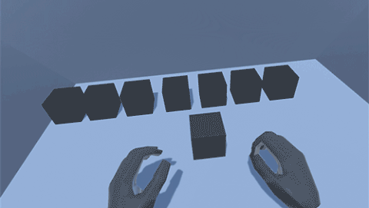
Training description

Slide 6
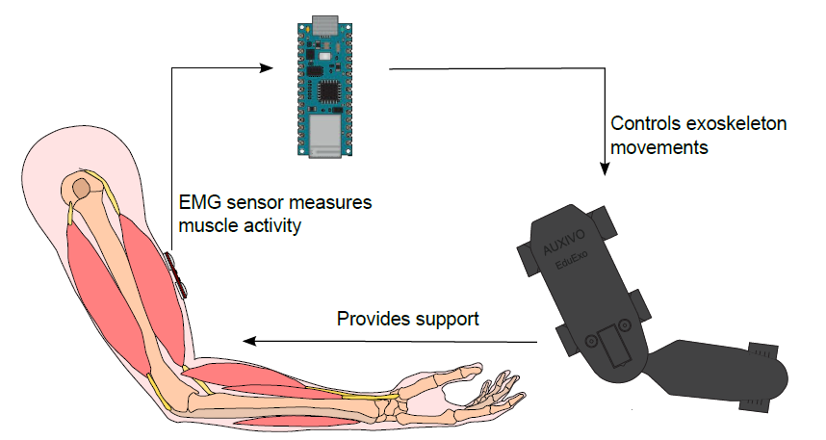
Conclusion
Our approach allows precise control of the elbow's flexion angle within the Unity platform, enabling optimal training and rehabilitation tailored to the patient's needs.
Martina Adler, Sophia Pelligrini, Sandro Müller, Julia Jackermaier
EduExo2 Handbook

Slide 7
Rehabilitation Session Workflow
In the physical world, force is applied through a pinching motion when an object is grasped
This applied force is detected by an Electromyography (EMG) sensor, initiating the Unity application
Within the Unity application, an object materializes in the user's virtual hand
A stepper motor provides guidance, directing the arm to a specific angle within the elbow joint
The actual joint angle is continuously monitored through a motor encoder
If the patient exceeds the target angle, the device offers resistance to deter further movement
Multiple training sessions are conducted to familiarize patients with their current rehabilitation status
Martina Adler, Sophia Pelligrini, Sandro Müller, Julia Jackermaier

Slide 8

Benefits and Considerations
Potential benefits include enhanced patient rehabilitation and reduced risk of joint re-injury
The Unity platform's flexibility permits accurate angle adjustments for personalized treatment
Martina Adler, Sophia Pelligrini, Sandro Müller, Julia Jackermaier
https://cdn2.vectorstock.com/i/1000x1000/02/36/physical-rehabilitation-hands-icon-outline-style-vector-35930236.jpg

